Slide 1
CSE 3002- programming in java unit Iv date / time api
Dr. R. Manikandan
Assistant professor (senior grade)
Vit bhopal university

Slide 2
Why Is Date and Time Important?
In the development of applications, programmers often need to represent time and use it to perform calculations:
Current time and date are used to calculate events in the future, and as timestamps.
Calculating a time or date offset is important when determining what the time and date are when n hours or n days are added to a date.
Determining time and date in other countries is often a critical factor in determining when meetings happen, or what the local time is when a plane lands.
The number of days in the month of February (leap years)
The difference between two dates/time in seconds, minutes, hours, days, months, years
A time duration (hours, mins, secs) or a period (years, months, days)
Notes:
Current time and date are used to calculate events in the future, and as timestamps.
Calculating a time or date offset is important when determining what the time and date are when n hours or n days are added to a date.
Determining time and date in other countries is often a critical factor in determining when meetings happen, or what the local time is when a plane lands.
Leap years are incredibly tricky to manage.

Slide 3
Existing Date/Time APIs: Issues
Disadvantages of java.util.Date (Calendar, TimeZone & DateFormat
Thread Safety
The Date and Calendar classes are not thread safe, leaving developers to deal with the headache of hard to debug concurrency issues and to write additional code to handle thread safety.
APIs Design and Ease of Understanding
The Date and Calendar APIs are poorly designed with inadequate methods to perform day-to-day operations. The new Date/Time APIs is ISO centric and follows consistent domain models for date, time, duration and periods.
The ISO Calendar is also known as the Gregorian calendar in JDK code. The ISO calendar system applies the current rules for leap years both forward and backward in time.
ZonedDate and Time
Developers had to write additional logic to handle timezone logic with the old APIs, whereas with the new APIs, handling of timezone can be done with Local and ZonedDate/Time APIs.
Notes:
Current time and date are used to calculate events in the future, and as timestamps.
Calculating a time or date offset is important when determining what the time and date are when n hours or n days are added to a date.
Determining time and date in other countries is often a critical factor in determining when meetings happen, or what the local time is when a plane lands.
Leap years are incredibly tricky to manage.

Slide 4
Java does not have a built-in Date class, but we can import the java.time package to work with the date and time API. The package includes many date and time classes.
For example:
Class | Description
LocalDate | Represents a date (year, month, day (yyyy-MM-dd))
LocalTime | Represents a time (hour, minute, second and microsecond (HH-mm-se-zzz))
LocalDateTime | Represents both a date and a time (yyyy-MM-dd-HH-mm-ss.zzz)
DateTimeFormatter | Formatter for displaying and parsing date-time objects

Slide 5
Working with Local Date and Time
The java.time API defines two classes for working with local dates and times (without a time zone):
LocalDate:
Does not include time
A year-month-day representation
toString – ISO 8601 format (YYYY-MM-DD)
ISO-8601 defines the international format of dates as the year first, followed by the month, day, hour, minutes, and seconds. The definition is based on the relative importance of each unit of time.
LocalTime:
Does not include date
Stores hours:minutes:seconds.nanoseconds
toString – (HH:mm:ss.SSSS)
Notes:
ISO-8601 defines the international format of dates as the year first, followed by the month, day, hour, minutes, and seconds. The definition is based on the relative importance of each unit of time.

Slide 6
Working with LocalDate
LocalDate is a class that holds an event date: a birth date, anniversary, meeting date, and so on.
A date is a label for a day.
LocalDate uses the ISO calendar by default. ISO format (yyyy-MM-dd) without time
LocalDate does not include time, so it is portable across time zones.
You can answer the following questions about dates with LocalDate:
Is it in the future or past?
Is it in a leap year?
What day of the week is it?
What is the day a month from now?
What is the date next Tuesday?
Example: LocalDateExample.java, LocalDateExample1.java, TemporalAdjusters.java
Notes:
java.util.Date includes a time, and developers would often use midnight to represent just a date. But some time zones do not have a midnight depending upon where they are in day light savings time.

Slide 7
Working with LocalTime
LocalTime stores the time within a day.
Measured from midnight
Based on a 24-hour clock (13:30 is 1:30 PM.)
Questions you can answer about time with LocalTime
When is my lunch time?
Is lunch time in the future or past?
What is the time 1 hour 15 minutes from now?
How many minutes until lunch time?
How many hours until bedtime?
How do I keep track of just the hours and minutes?
Example: LocalTimeExample.java

Slide 8
Working with LocalDateTime
LocalDateTime is a combination of LocalDate and LocalTime.
LocalDateTime is useful for narrowing events.
You can answer the following questions with LocalDateTime:
When is the meeting with corporate?
When does my flight leave?
When does the course start?
If I move the meeting to Friday, what is the date?
If the course starts at 9 AM on Monday and ends at 5 PM on Friday, how many hours am I in class?
Example: LocalDateTimeExample.java, LocalDatesAndTimes.java,

Slide 9
Working with Time Zones
A time zone is a region of the globe that observes a uniform standard time for legal, commercial, and social purposes.
Time zones tend to follow the boundaries of countries and their subdivisions because it is convenient for areas in close commercial or other communication to keep the same time.
Most of the time zones on land are offset from Coordinated Universal Time (UTC) by a whole number of hours (UTC−12:00 to UTC+14:00), but a few zones are offset by 30 or 45 minutes.
Ex: Newfoundland Standard Time is UTC−03:30, Nepal Standard Time is UTC+05:45, and Indian Standard Time is UTC+05:30.
Notes:
Time zones are relative to the Coordinated Universal Time (UTC).
Time rules are based on the offset from UTC:
New York is UTC – 5 hours during standard time.
New York is UTC – 4 hours during daylight savings.
Daylight savings can change from year to year, and sometimes even in a single year.
USA DST started: 3/14/2010, 3/13/2011, 3/12/2012, 3/10/2013, 3/9/2014, and so on
Arizona does not recognize DST.
Egypt had two DST periods in 2010, and no DST changes since 2011.

Slide 10
Working with Time Zones
GMT is a time zone officially used in some European and African countries. The time can be displayed using both the 24-hour format (0 - 24) or the 12-hour format (1 - 12 am/pm).
UTC is not a time zone, but a time standard that is the basis for civil time and time zones worldwide. This means that no country or territory officially uses UTC as a local time.
India Standard Time (IST) is 5:30 hours ahead of Coordinated Universal Time (UTC).
Daylight Saving Time (DST) is the practice of setting the clocks forward one hour from standard time during the summer months, and back again in the fall, in order to make better use of natural daylight.
“EST” stands for “Eastern Standard Time” while “EDT” is the abbreviation for “Eastern Daylight Time.” Both refer to time zones used in the same area but in different parts of the year.
The time method for the seasons of summer – spring
Notes:
Time zones are relative to the Coordinated Universal Time (UTC).
Time rules are based on the offset from UTC:
New York is UTC – 5 hours during standard time.
New York is UTC – 4 hours during daylight savings.
Daylight savings can change from year to year, and sometimes even in a single year.
USA DST started: 3/14/2010, 3/13/2011, 3/12/2012, 3/10/2013, 3/9/2014, and so on
Arizona does not recognize DST.
Egypt had two DST periods in 2010, and no DST changes since 2011.

Slide 11
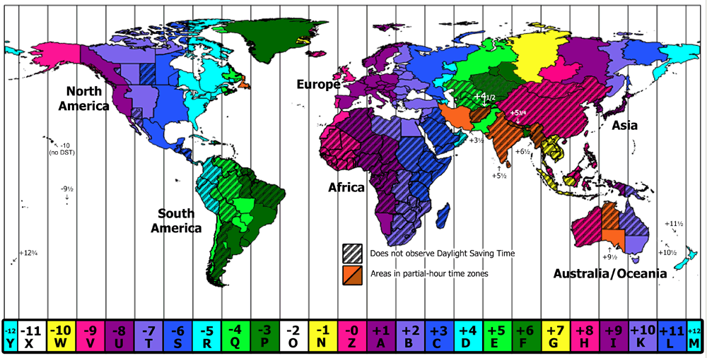
Working with Time Zones
How many time zones are in India?
Only one time zone known as IST(Indian Standard Time). Its GMT +5:30Hrs i.e., 5:30 hrs ahead of GMT (Greenwich Mean Time). India does not have any Daylight Saving Time & Seasonal adjustments.
Notes:
Time zones are relative to the Coordinated Universal Time (UTC).
Time rules are based on the offset from UTC:
New York is UTC – 5 hours during standard time.
New York is UTC – 4 hours during daylight savings.
Daylight savings can change from year to year, and sometimes even in a single year.
USA DST started: 3/14/2010, 3/13/2011, 3/12/2012, 3/10/2013, 3/9/2014, and so on
Arizona does not recognize DST.
Egypt had two DST periods in 2010, and no DST changes since 2011.

Slide 12
Modeling Time Zones
ZoneId: Is a specific location or offset relative to UTC
ZoneId nyTZ = ZoneId.of("America/New_York");
ZoneId EST = ZoneId.of("US/Eastern");
ZoneId Romeo = ZoneId.of("Europe/London");
ZoneOffset: Extends ZoneId; specifies the actual time difference from UTC
ZoneOffset USEast = ZoneOffset.of("-5");
ZoneOffset Nepal = ZoneOffset.ofHoursMinutes(5, 45);
ZoneId EST = ZoneId.ofOffset("UTC", USEast);
ZoneRules: Is the class used to determine offsets
The relationship between these objects is that a ZoneId is a specific time zone that falls within a ZoneOffset.
ZoneRules are used with a ZoneId to determine changes in the ZoneOffset based on the specific date and daylight savings time changes.
Notes:
The relationship between these objects is that a ZoneId is a specific time zone that falls within a ZoneOffset. ZoneRules are used with a ZoneId to determine changes in the ZoneOffset based on the specific date and daylight savings time changes.

Slide 13
Creating ZonedDateTime Objects
Stores LocalDateTime, ZoneId, and ZoneOffset
ZoneId USEast = ZoneId.of("America/New_York");
LocalDate date = LocalDate.of(2014, MARCH, 23);
LocalTime time = LocalTime.of(9, 30);
LocalDateTime dateTime = LocalDateTime.of(date, time);
ZonedDateTime courseStart = ZonedDateTime.of(date, time, USEast);
ZonedDateTime hereNow = ZonedDateTime.now(USEast).truncatedTo(MINUTES);
System.out.println("Here now: " + hereNow);
System.out.println("Course start: " + courseStart);
ZonedDateTime newCourseStart = courseStart.plusDays(2).minusMinutes(30);
System.out.println("New Course Start: " + newCourseStart);
Here now: 2014-02-19 T 17:00 -05:00[America/New_York]
Course start: 2014-03-23 T 09:30 -04:00[America/New_York]
New Course Start: 2014-03-25 T 09:00 -04:00[America/New_York]

Slide 14
Working with ZonedDateTime Gaps/Overlaps
Given a meeting date the day before daylight savings (2AM on March 9th), what happens if the meeting is moved out by a day?
// DST Begins March 9th, 2014
LocalDate meetDate = LocalDate.of(2014, MARCH, 8);
LocalTime meetTime = LocalTime.of(16, 00);
ZonedDateTime meeting = ZonedDateTime.of(meetDate, meetTime, USEast);
System.out.println("meeting time: " + meeting);
ZonedDateTime newMeeting = meeting.plusDays(1);
System.out.println("new meeting time: " + newMeeting
meeting time: 2014-03-08 16:00 -05:00[America/New_York]
new meeting time: 2014-03-09 16:00 -04:00[America/New_York]
The local time is not changed, and the offset is managed correctly.
Notes:
Likewise, the overlaps are also handled in the same way:
// DST Ends November 2nd, 2014
meetDate = LocalDate.of(2104, NOVEMBER, 1);
meeting = ZonedDateTime.of(meetDate, meetTime, USEast);
System.out.println("meeting time: " + meeting);
newMeeting = meeting.plusDays(1);
System.out.println("new meeting time: " + newMeeting);

Slide 15
Working Across Time Zones
The OffsetDateTime class stores a LocalDateTime and ZoneOffset.
This is useful for determining ZonedDateTimes across time zones.
Java ZoneOffset class is used to represent the fixed zone offset from UTC time zone.
LocalDateTime meeting = LocalDateTime.of(2014, JUNE, 13, 12, 30);
ZoneId SanFran = ZoneId.of("America/Los_Angeles");
ZonedDateTime staffCall = ZonedDateTime.of(meeting, SanFran);
OffsetDateTime = staffCall.toOffsetDateTime();
The offset is used to calculate date/time using zone rules:
ZoneId London = ZoneId.of("Europe/London");
OffsetDateTime staffCallOffset = staffCall.toOffsetDateTime();
ZonedDateTime staffCallUK = staffCallOffset.atZoneSameInstant(London);
System.out.println("Staff call (Pacific) is at: " + staffCall);
System.out.println("Staff call (UK) is at: " + staffCallUK);
Example: Zone.java, ZonedDateTimeExample.java
Notes:
The easiest way to get an OffsetDateTime is from a ZonedDateTime by using the toOffsetDateTime method.
Output:
Staff call (Pacific) is at: 2014-06-13T12:30-07:00[America/Los_Angeles]
Staff call (UK) is at: 2014-06-13T20:30+01:00[Europe/London]

Slide 16
Period and Duration
Period and Duration classes : Period : It deals with date based amount of time. Duration : It deals with time based amount of time.
Example: PeriodDuration.java
Using Fluent Notation: To make readable
Example: // Not very readable - is this June 11 or November 6th?
LocalDate myBday = LocalDate.of(1970, 6, 11);
// A fluent approach
myBday = Year.of(1970).atMonth(JUNE).atDay(11);
// Schedule a meeting fluently
LocalDateTime meeting = LocalDate.of(2014, MARCH, 25).atTime(12, 30);
// Schedule that meeting using the London timezone
ZonedDateTime meetingUK = meeting.atZone(ZoneId.of("Europe/London"));
// What time is it in San Francisco for that meeting?
ZonedDateTime earlyMeeting =
meetingUK.withZoneSameInstant(ZoneId.of("America/Los_Angeles"));
Notes:
Time zones are relative to the Coordinated Universal Time (UTC).
Time rules are based on the offset from UTC:
New York is UTC – 5 hours during standard time.
New York is UTC – 4 hours during daylight savings.
Daylight savings can change from year to year, and sometimes even in a single year.
USA DST started: 3/14/2010, 3/13/2011, 3/12/2012, 3/10/2013, 3/9/2014, and so on
Arizona does not recognize DST.
Egypt had two DST periods in 2010, and no DST changes since 2011.

